Slide 1
A Survey of Dialogue System Research
*survey is based on papers published in 2014 and after

Slide 2
Outline
Overview
Language Understanding
Dialogue Management
Natural Language Generation
End-to-End Learning
Breakdown Detection

Slide 3
Overview
A classification of dialogue system (DS)
Task-oriented DS
Task-less (or chit-chat) DS

Slide 4
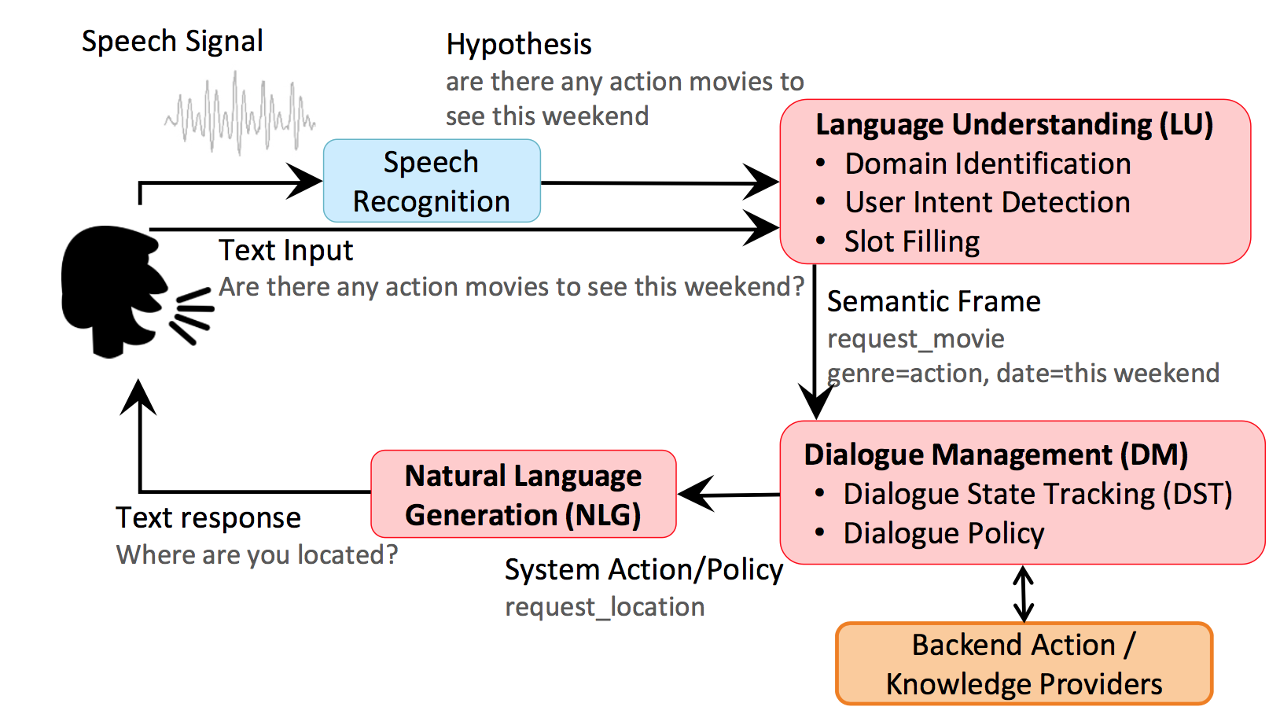
Task-oriented DS

Slide 5
Language Understanding
Three modules:
Domain classification
Intent classification
Slot filling

Slide 6
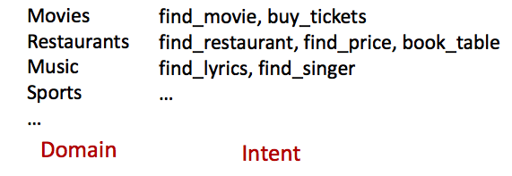
LU: Domain/Intent Classification
Find me a cheap Taiwanese restaurant in Oakland

Slide 7
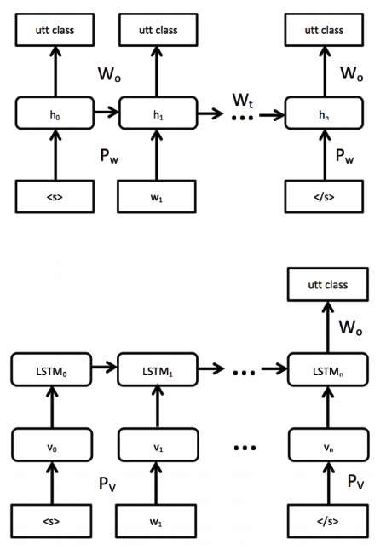
LU: Domain/Intent Classification
Challenges:
addressee detection
Sparseness of n-gram
Large number of singletons
Approaches:
RNN with LSTM to solve both domain/intent classification and addressee detection
Word-hashing to resolve singleton
Kat: #Ka, Kat, at#

Slide 8
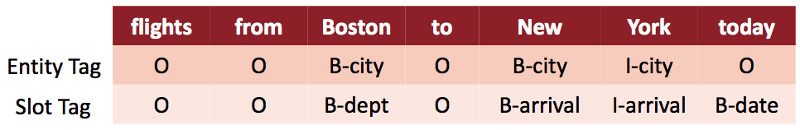
LU: Slot Filling
Flights from Boston to New York today

Slide 9
LU: Slot Filling
Challenges:
to model dependencies between labels
To capture contextual information
Approaches:
RNN with LSTM
LSTM-look around (the input is n-grams)
bLSTM
Encoder-decoder networks
Attention based encoder-decoder

Slide 10
LU: Joint-learning and Multi-domain
Motivation:
to prevent error propagation in the pipeline approach
to reduce the number of training data required for each domain

Slide 11
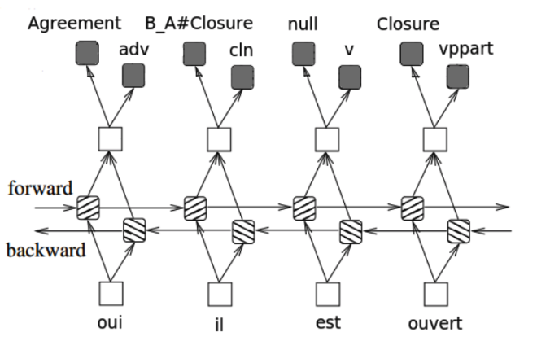
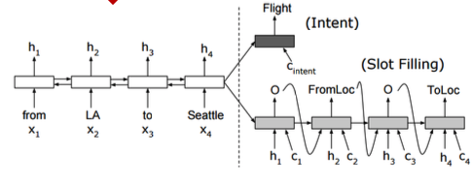
LU: Joint-learning and Multi-domain
Multi-task bLSTM (POS, disfluency, NER, frame label)
Slot filling and intent prediction at the same times

Slide 12
LU: Contextual
Motivation: many works exploit adjacency pair of utterances, not the history of dialogue
Approaches:
LSTM over the whole dialogue
Knowledge guided attention network (memory network)

Slide 13
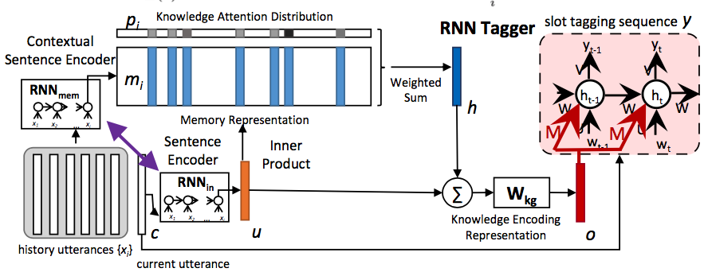
Knowledge guided attention network

Slide 14
Dialogue Management
Dialogue State Tracking
Dialogue Policy

Slide 15
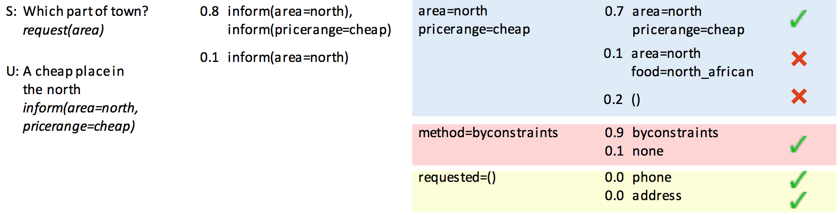
DM: Dialogue State Tracking

Slide 16
DM: Dialogue State Tracking
Challenges:
A DST that can work on many domains
Approaches:
To train one generalized RNN model (replace all slot name and slot value with placeholder)
and then specialized it for each slot name

Slide 17
DM: Dialogue Policy
Task: to guide what the system should say
Motivation:
To develop a generic RL algorithm to learn dialogue policy for all domains
Challenges:
Number of dialogues for training
Domain expertise
Approaches:
RL algorithms with different reward (e.g. #turns maximized or minimized)
User simulation (to generate enough data using dialogue history)

Slide 18
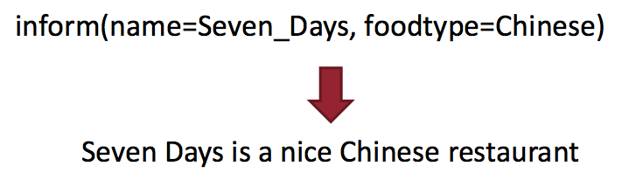
Language Generation
To map dialogue acts into natural language

Slide 19
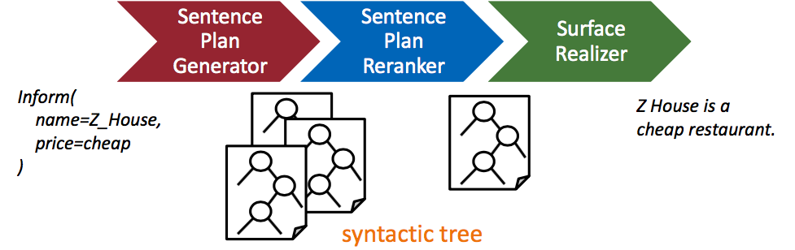
LG: Statistical NLG

Slide 20
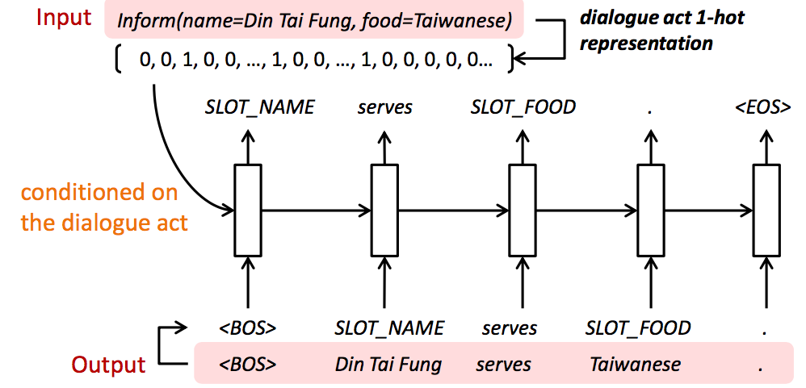
LG: NN

Slide 21
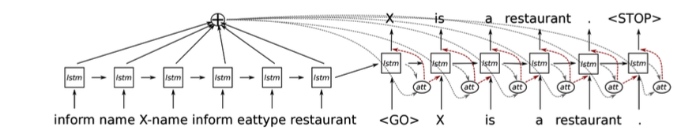
LG: NN

Slide 22
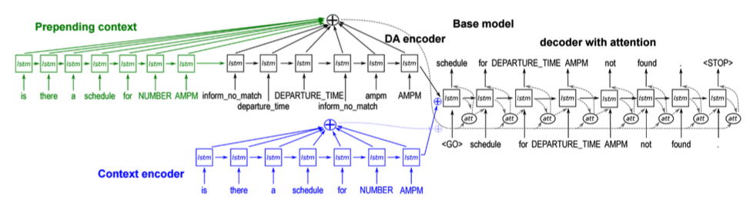
LG: Contextual

Slide 23
End-to-End
ChitChat
Task-oriented

Slide 24
ChitChat
Motivation:
To model dialogue without directly measurable goals
To train task-less DS using task-oriented data to obtain task-oriented DS
Challenges:
To model topic in the DS
Dull response
Approaches:
Seq2seq with MMI, deep RL, personalized DS (using user’s personal history),
IR-based technique (using twitter data)

Slide 25
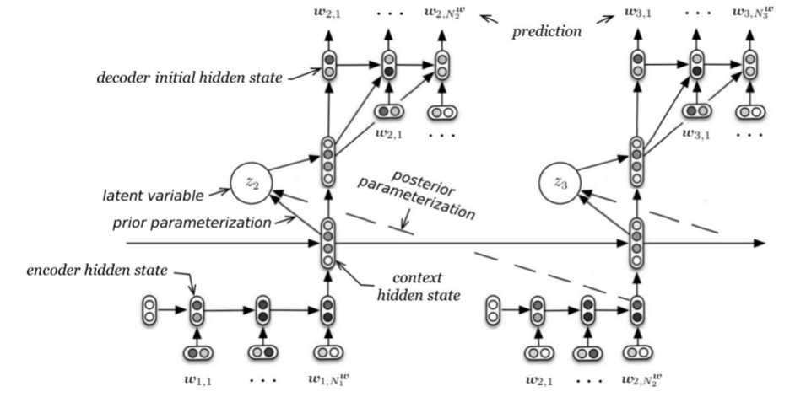

Slide 26
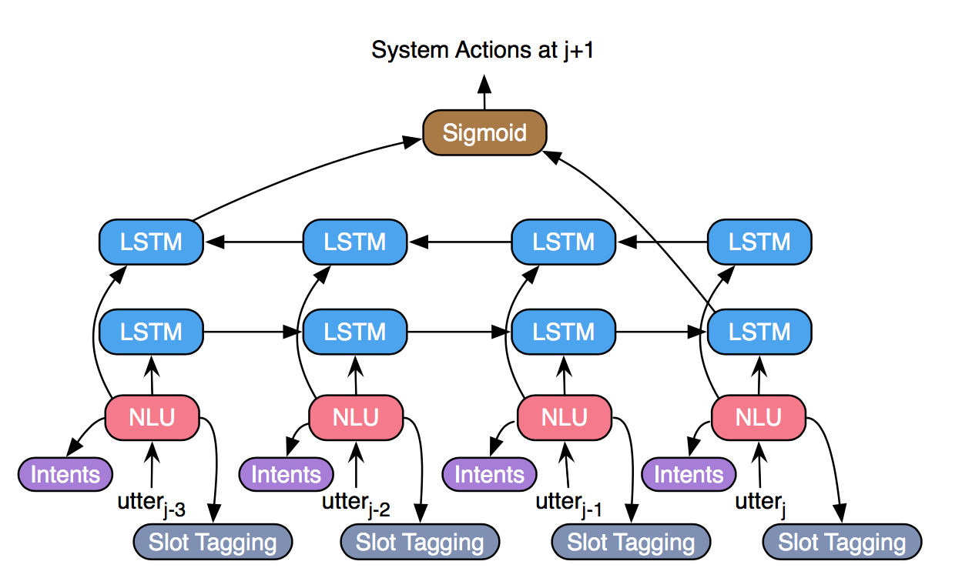
E2E: Task Oriented (Supervised Learning)
Notes:
No need to model dialogue policy

Slide 27
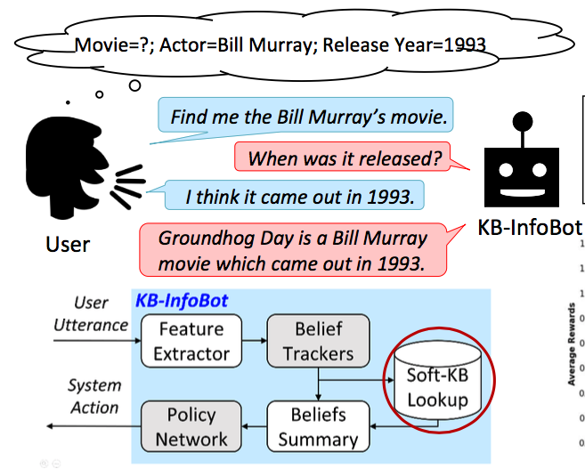
E2E: Task Oriented (Reinforcement Learning)
To traverse knowledge base

Slide 28
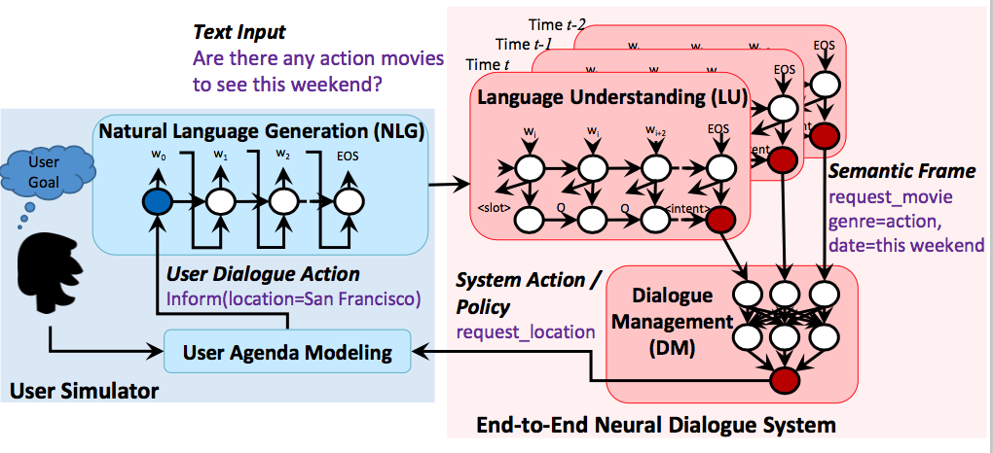
E2E Task-Oriented (RL)

Slide 29
Breakdown

Slide 30
Breakdown Detection: Overview
Breakdown: massive deviation from the user’s conversational expectations (Martinovsky 03)
Not about completing a task, but
user feels he is interacting with an incompetent conversational partner

Slide 31
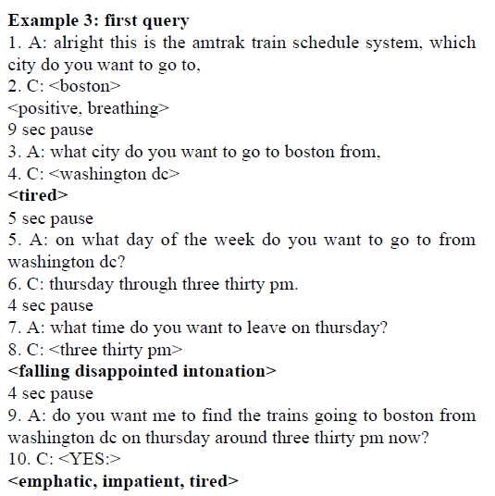
Example of breakdown

Slide 32
Works related to breakdown
(Krahmer 01): prevent breakdown by detecting error in communication early.
(Martinovsky 03): breakdown is due to long pauses, over-fragmentation, over-clarity, repetitiveness of syntax, etc.
(Higashinaka 15,16): breakdown is a situation where users cannot (or will not) proceed with the conversation.
The breakdown detection challenge: 6 participants

Slide 33
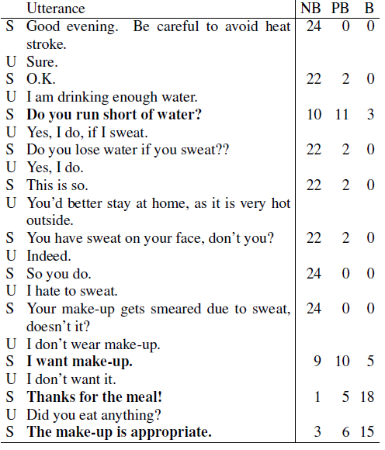
Breakdown detection challenge (BDC)
(Martinovsky 03)
(Higashinaka 15, 16)

Slide 34
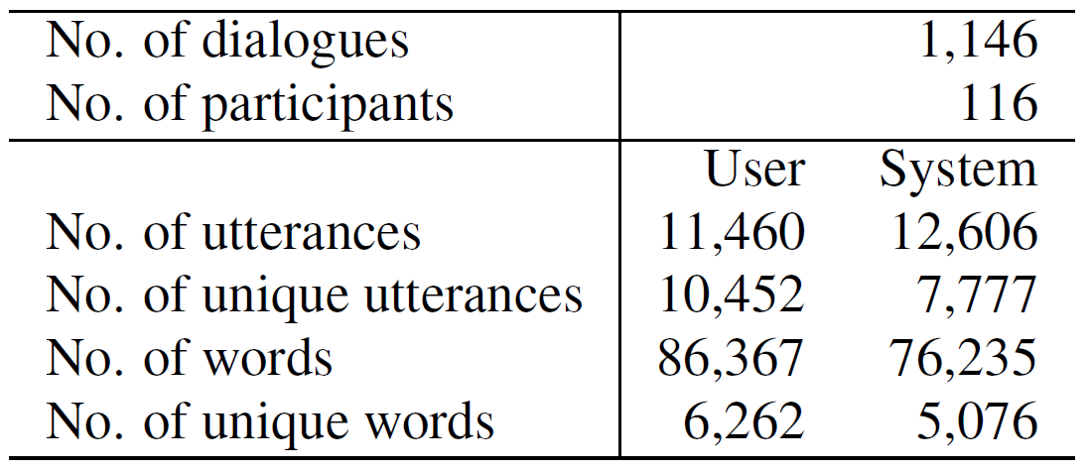
BDC - Dataset
116 participants chat with a dialogue system (NTT Docomo API)

Slide 35
BDC – Annotation 1 (Higashinaka ERARE’15)
Annotation scheme for each utterance:
(NB) Not a breakdown
(PB) Possible breakdown
(B) Breakdown
Annotators: 24
Annotators mainly judge by the attributes of:
Meaning (understanding), response (clarity), …, repetition

Slide 36
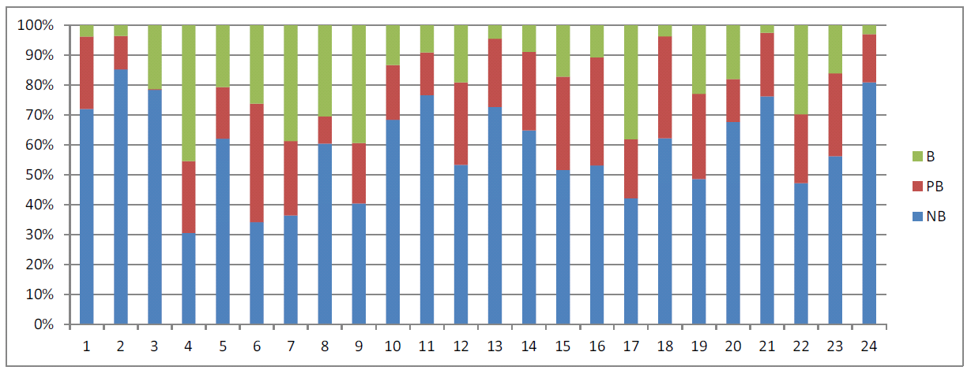
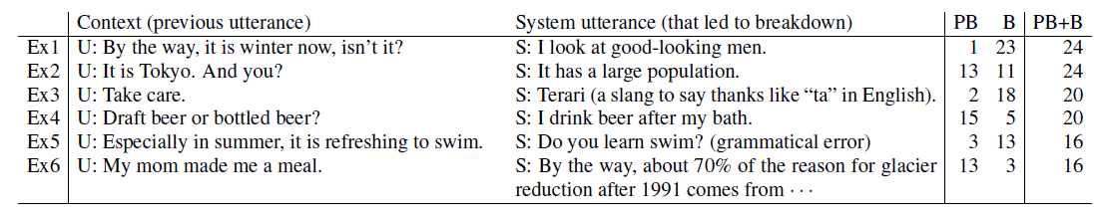
BDC – Annotation 1 (Higashinaka ERARE’15)
highly
subjective

Slide 37
BDC – Annotation 2 (taxonomy of errors) by (Higashinaka EMNLP, SIGDIAL’15)
Same dataset as previous annotation
Annotation schema:
Utterance-level
syntactic error, semantic error, uninterpretable
Response-level
lack of information, non-understanding, no relevance
Context-level
lack of proposition, contradiction, topic switch
Environment-level
common sense, sociality
Annotators: 3

Slide 38
BDC – Annotation 2 (taxonomy of errors) by (Higashinaka SIGDIAL’15)
Inter-annotator agreement:
Main category : 0.400
Subcategory : 0.239

Slide 39
BDC – The Task (JSAI SIG-SLUD)
Using the annotation #1
Classify each system’s utterance into NB, PB, or B.
Evaluation: classification-related metrics (F-score) and distribution-related metrics (MSE)
#teams: 6

Slide 40
Kyoto Institute of Technology
Poly kernel SVM
Features: word vector both in the system utterance and the previous user utterance (modified combinations of these utterances)
Shizuoka University
Handcrafted rules
I: if there is no shared keywords between system’s and user’s utterance, then it is a breakdown
II: system’s utterance after user’s question is a breakdown
III: system’s utterance which is a question is a breakdown

Slide 41
Tohoku University and PFI (best MSE)
Encode a pair of user’s and system’s utterance using NCM, LSTM encoder, BOW, or extended NCM
NAIST
LSTM-RNN
Features: word frequency vector (user and system), frequency vector of co-occurrence words, doc2vec (user, system, co-occurrence)

Slide 42
NTT Communication (best F-score)
6-layer perceptron
Features: word vector (user and system), word class vector (user and system), perplexity, cosine similarity (system and previous system), personality question, dialogue acts (SVM)
Hiroshima City University
LSTM-RNN
Features: word2vec of user’s and system’s utterances

Slide 43
Difference between breakdown and our task
word vector,
term cooccurrence
synonyms, paraphrase,
knowledge base
Feature 1
Feature 2
Feature 3
Breakdown
detection
Log analysis
Bad Response
Approach:
To use surface form of utterance
in dialogue
Approach:
For each utterance,
we examine all Q’s in database

